Slide 1
Variant Detection
MED676 – Bioinformatics Module
By Dennis Wang
Adapted from Marta Bleda Latorre’s 2016 lecture

Slide 2
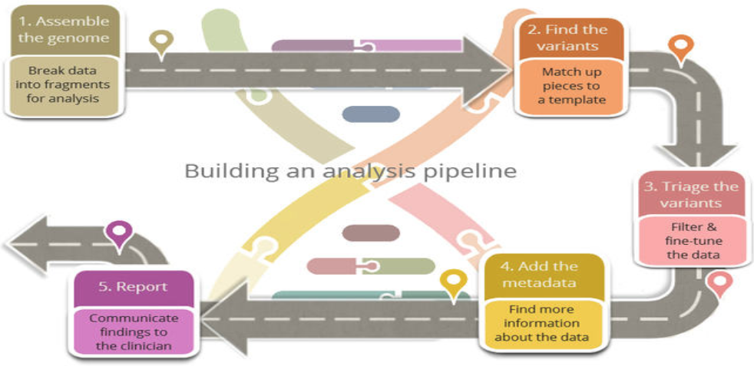
2. Find the variants

Slide 3

Objective
Assign a genotype to each position
PCR artefacts
Mismatches due to errors in early PCR rounds
PCR duplicates
Sequencing errors: erroneous calls, either due to sequencer or properties of sequenced DNA
Mis-alignments due to errors in early PCR rounds
PCR duplicates
Mapping errors: often happens around repeats or low-complexity regions
Separate true variation from machine artefacts

Slide 4
Variant calling pipeline
Mark PCR duplicates
Duplicates should not be counted as additional evidence
Local realignments around INDELs
Reads mapping on the edges of INDELs often get mapped with mismatching bases introducing false SNVs
Base quality score recalibration (BQSR)
Quality scores provided by sequencing machines are generally inaccurate and biased
Variant calling
Find where they are along the genome and statistically test their significance

Slide 5
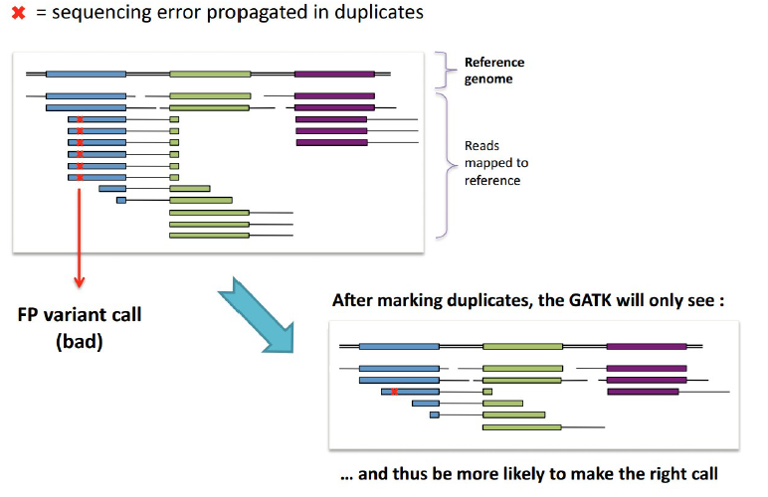
1. Why mark duplicates
Tools
Samtools: samtools rmdup
Picard: MarkDuplicates

Slide 6
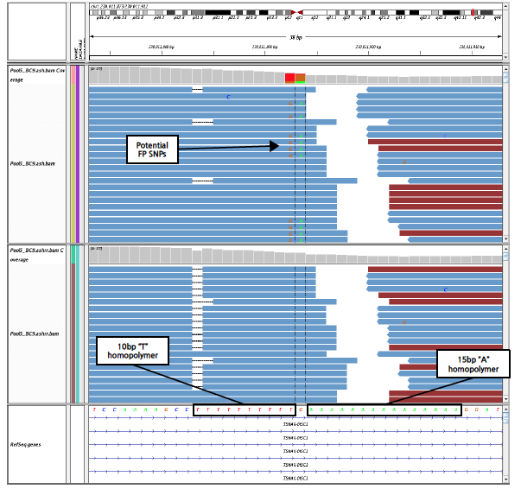
2. Why local realign around INDELs
Reads near INDELs are aligned with mismatches
After realignment:
Mismatches with the reference sequence are minimized
Location of the INDELs are refined

Slide 7
3. Base quality score recalibration
Sometimes errors and artefacts can even influence the quality scores.
Must ensure quality scores are objective and not biased, because we rely on them for variant calling
How do we re-calibrate?
Analyze covariation among several features of a base:
- reported quality score
- position within the read
- preceding and current nucleotide
2. Use a set of known variants (ie. dbSNP) to learn about the quality of real polymorphisms
3. Adjust the quality scores of all reads in a BAM
Machine learning is used here

Slide 8
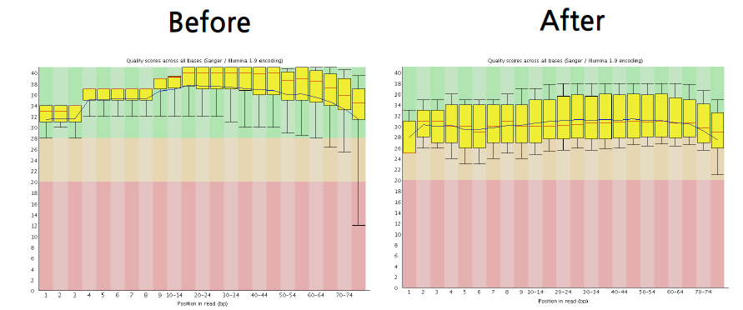
3. Base quality score recalibration
PHRED score

Slide 9
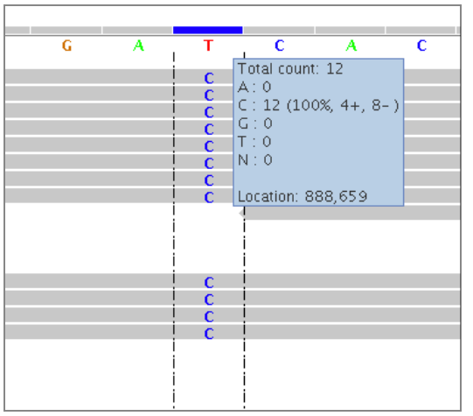
4. Variant calling
Steps:
Variant calling: Identify the positions that differ from the reference
Genotype calling: calculate the genotypes of the individual at these sites
Initial approach (What you did in IGV):
Assume each base and position is independent
Count the number of times each allele is observed
Probabilistic approach
Compute genotype likelihood
Provide statistical measure of uncertainty
Lead to higher accuracy of calling variants

Slide 10
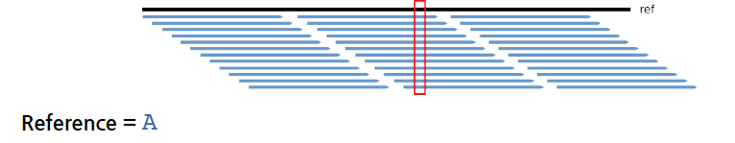
4. Variant calling

Slide 11
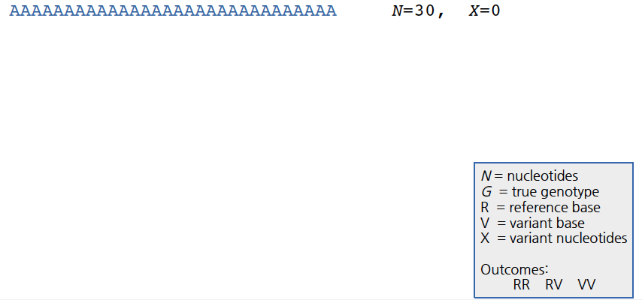
4. Variant calling

Slide 12
4. Variant calling

Slide 13
4. Variant calling

Slide 14
4. Variant calling

Slide 15
4. Variant calling

Slide 16
4. Variant calling

Slide 17
4. Variant calling
What is the probability of AG genotype occurring at this position?

Slide 18
4. Variant calling
We want to test whether the AG genotype occurs at this position.

Slide 19
Statistical test
Reads at the position show:
What do we want from the statistical test?
P-value for AG genotype occurring
Probability of AG genotype occurring by chance
Probability of AG genotype occurring given the reads
Probability of AG genotype occurring given that the null hypothesis is true

Slide 20

4. Variant calling
Think Bayesian
P(G|D): Probability of Genotype given Data (posterior probability).
p(G): Prior probability of Genotype
p(D|G): Probability of Data given Genotype.
P(D): Probability of Data
* Probabilities need to be adjusted for Phred scores (1% error)

Slide 21
4. Variant calling
Think Bayesian
P(G|D): AG genotype given the reads.
p(G): Previously observed probability of AG genotype
p(D|G): Probability of reads given AG genotype.
P(D): Probability of seeing these reads (adjusting for base quality)

Slide 22
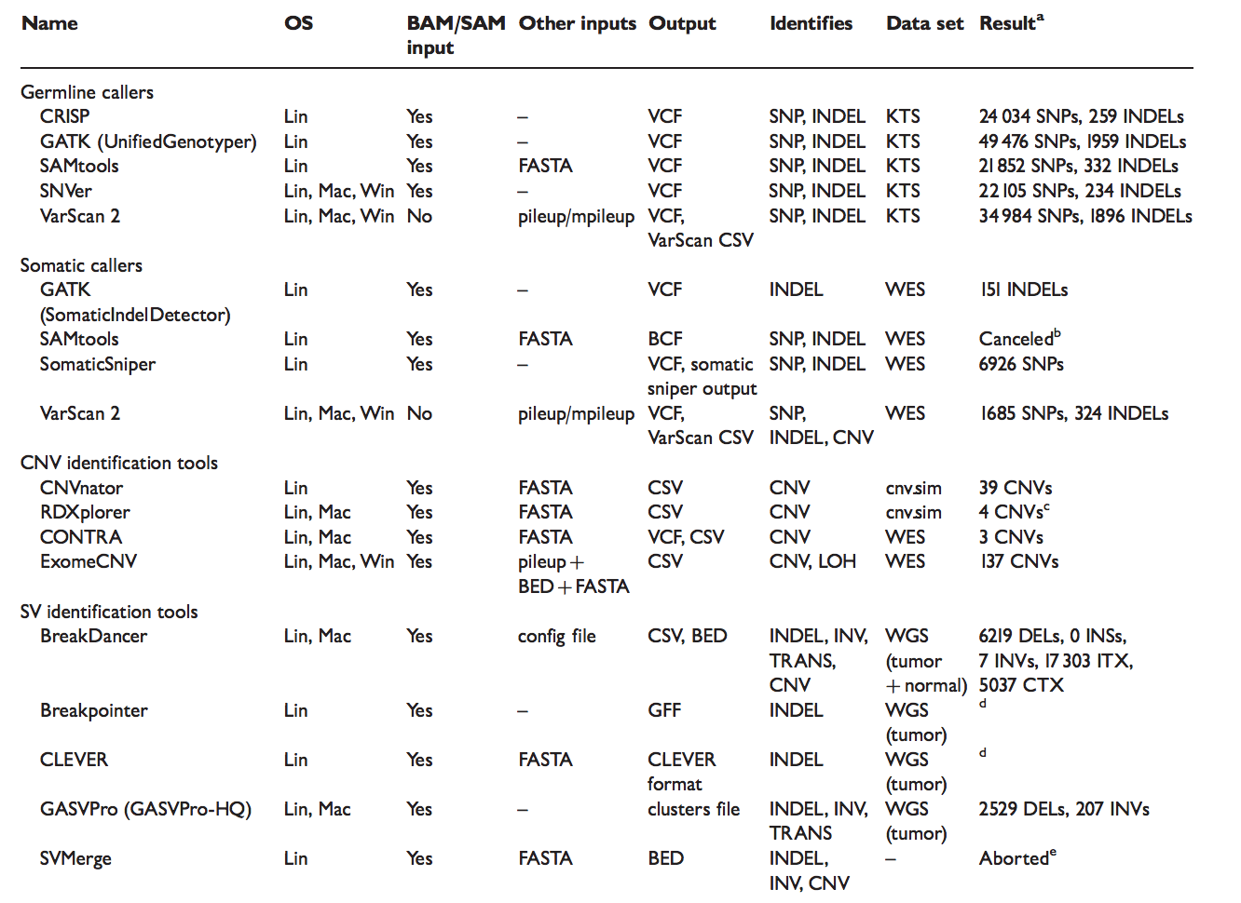
Variant callers
Pabinger et al. 2013 Brief. In Bioinfo.

Slide 23
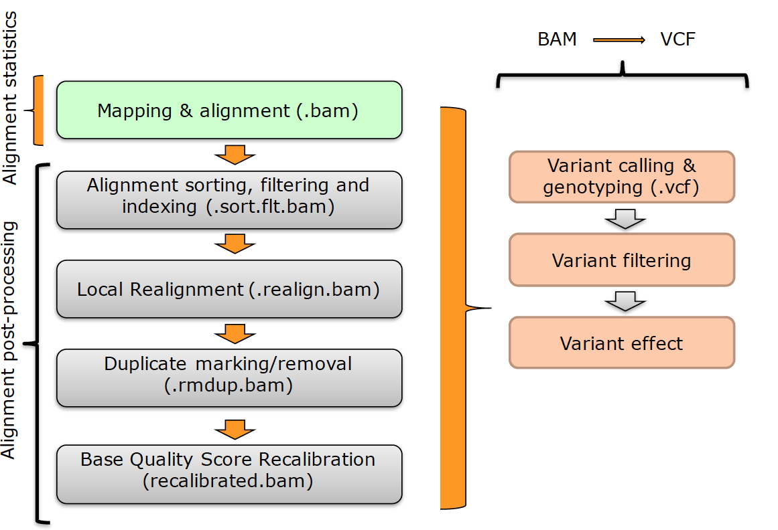
Data processing steps

